Slide 1
Random Original Graphic - part 2
A Cross-curricular project for Fine Arts

Slide 2
Warm-up
Random location for images

Slide 3
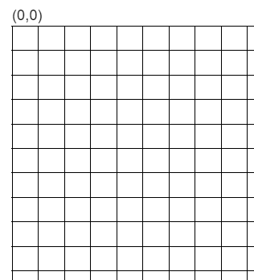
Creating an image with shapes
Think about the information you provide when drawing the shapes.
What information would be different if you wanted to draw the image in a different place?
What information would be the same?

Slide 4
Activity #1
Move a simple graphic to a different location on the display

Slide 5
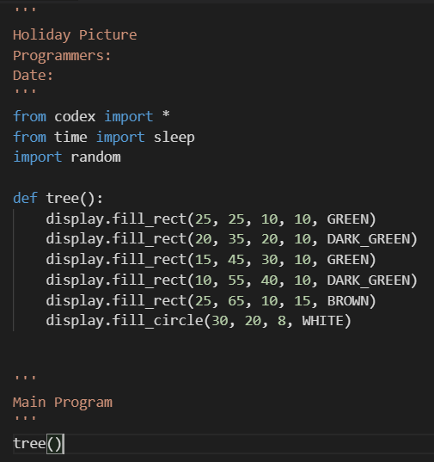
Using variables
Use variables for the pieces of information that need to change in order to move the shape.
You will need a variable for:
  The x location
  The y location
Identify the x and y values for each shape in your code
Note: if you use a line, it has two sets of x and y locations!
x locations
y locations

Slide 6
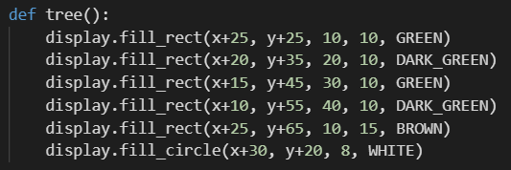
Using variables
In your code, add a “x + “ and “y + “ in front of each x and y location
Do not add anything to width, height or radius

Slide 7
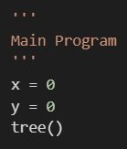
Using variables
Add the global variables x and y to your main program
Run your code again. Do you get the same results as before?

Slide 8
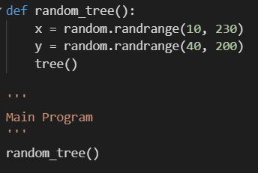
Using variables
This is great, but you know how to use functions in your code to complete a task.
Create a function that will get a random x and y and then call the original picture.
What values do you want to generate for x and y?
The display goes from 240 to 240, so you could use random.randrange(0, 240)
But, do you want to include the far edges?
It is up to you — you decide on the range for random numbers.

Slide 9
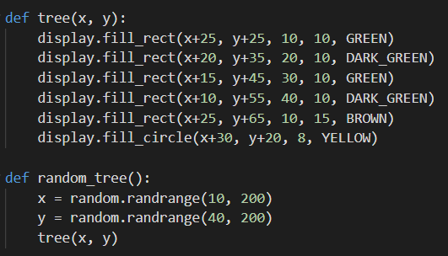
Using variables
Run your code. Do you see the error? Did you recognize the error before you ran the code?
x and y are no longer global – they are local to the function.
But that isn’t a problem.
Just use parameters in the holiday picture, and pass arguments when you call it.

Slide 10
Using variables
Run your code several times.
The holiday image should appear in a different location every time you run it

Slide 11
Activity #2
Use a loop to repeat the image

Slide 12
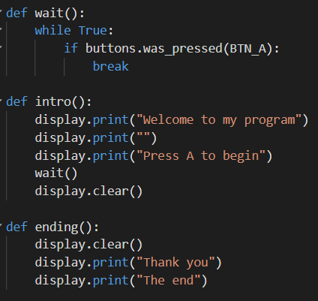
Repeat without restarting
You know that a user-friendly program should have an intro and an ending.
Create a function to wait until button A is pressed
Create a function for the intro and use the wait() function
Create a function for the ending
These functions use print statements. You can be more elaborate if you want.

Slide 13
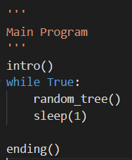
Repeat without restarting
Modify the main program to call the intro and then use a loop to continually call the random picture.
Run the code.
It should work without error. However, do you get the results you want?

Slide 14
Repeat without restarting
Two things:
The images appear over each other, not one image at a time
There is no way to actually end the program!

Slide 15
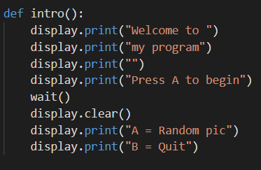
Repeat without restarting
Add instructions to the intro() that explain:
  button A to select the random picture
  button B to quit

Slide 16
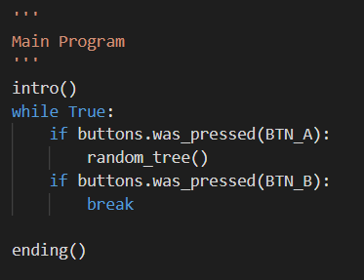
Repeat without restarting
You know how to do the next part:
Change the main program to use two if statements:
  button A to select the random picture
  button B to quit

Slide 17
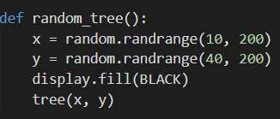
Repeat without restarting
Now the program has a way to end.
But… the images still appear on top of each other.
Add a display.fill() in the random image function
Pick the color you want for the background

Slide 18
Repeat without restarting
Run the code again – It should work correctly and without errors
Make any modifications you want
  Are the random numbers in a good range?
  Are the colors what you want?
  Do you want to jazz up the intro, instructions or ending?

Slide 19
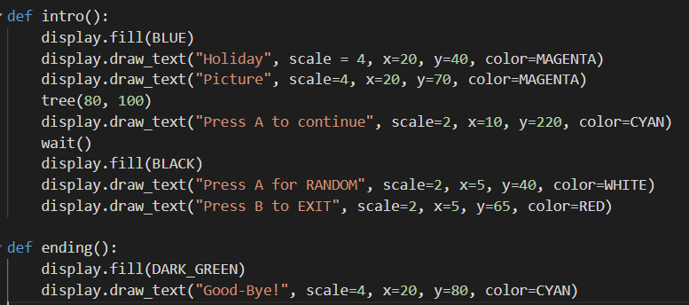
Repeat without restarting
An example of how you can jazz up the intro() and ending()

